Slide 1

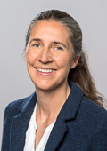
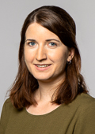
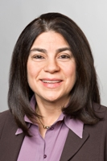
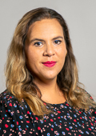
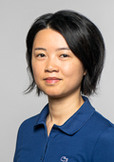
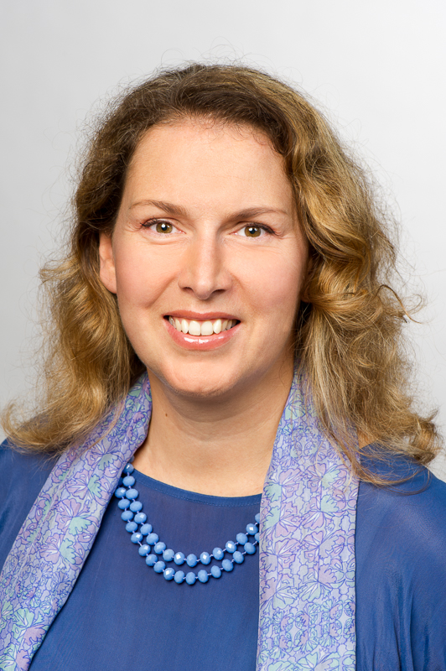

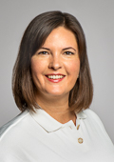
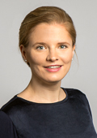
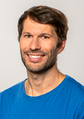
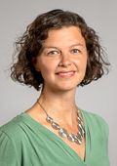
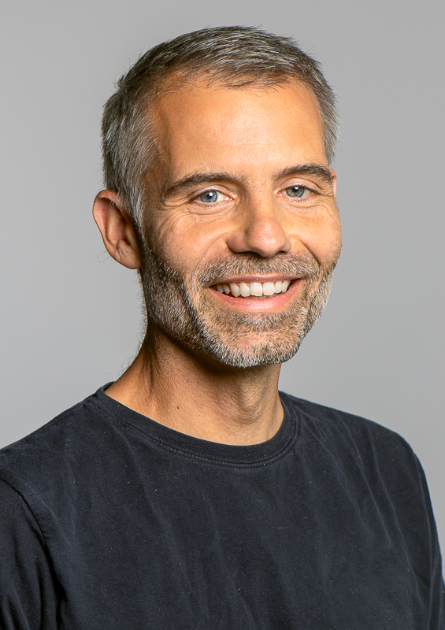
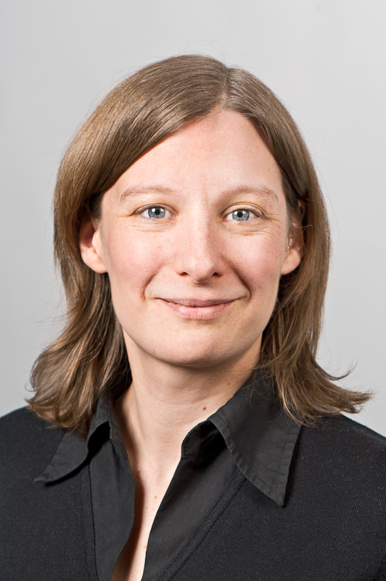
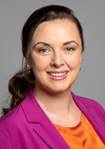

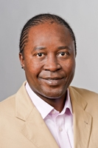
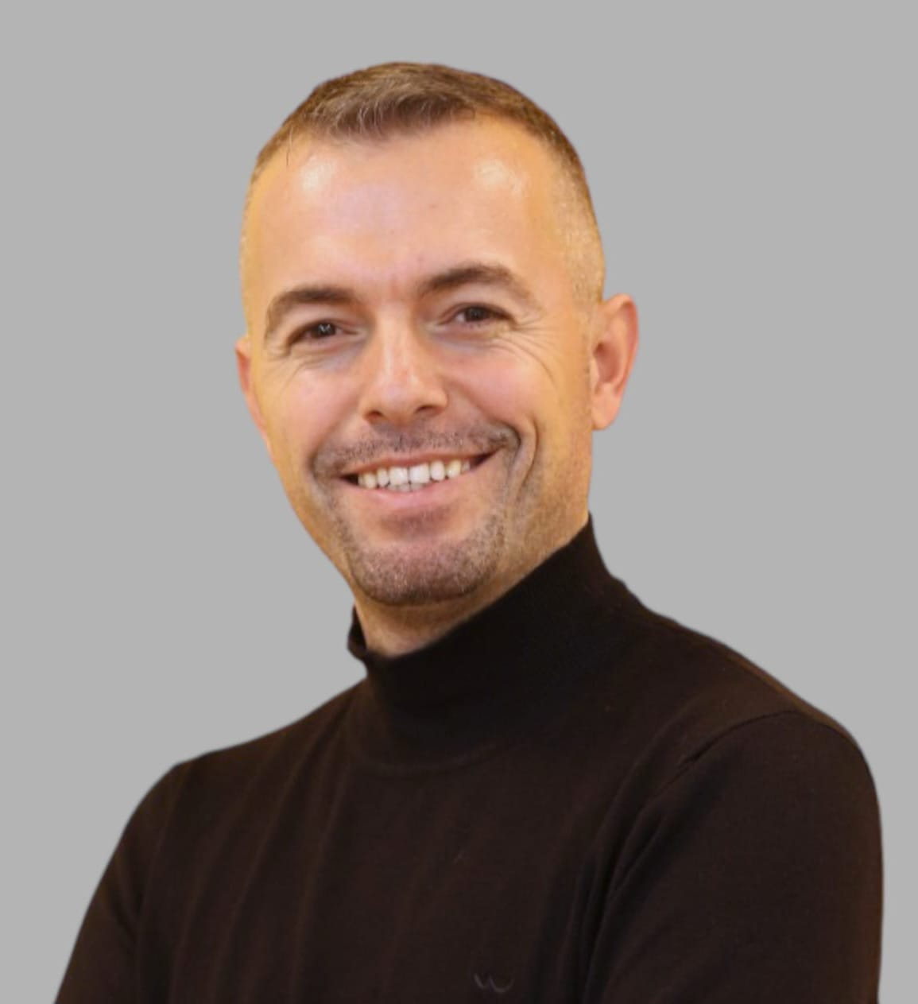
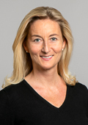
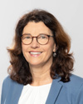
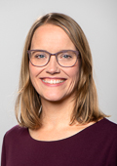
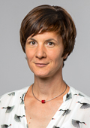
Student Advising and Information Services
Your personal point of contact at TUM Center for Study and Teaching
Munich, 09. October 2023

Slide 2



How do we support you?
You
Student Information
Studying with special needs
General Student Advising

Slide 3
Student Information
Personal contact point
We offer helpful information on study-related topics:
Basic information on application processes
Information material (e.g. financial aid, accommodation, exchange programs,…)
…
Visit us! We are happy to answer your individual questions!
Service Desk
Campus Munich
Arcisstr. 21
Opening hours:
Mon 9 am - 12 pm
Wed 9 am - 12 pm
Fri 9 am - 12 pm

Slide 4
General Student Advising
Personal contact for all issues related to your studies
We take time to take a close look at your
situation:
I do not feel comfortable in my study program – which alternatives do I have?
I am afraid of being exmatriculated – I am at a loss what to do now?
(Almost) graduated from Bachelor – how do I find the proper Master program?
…
Talking helps! We advise and provide options!
General Student Advising
Campus Munich
Arcisstr. 21
Book an appointment here.

Slide 5
General Student Advising
Personal contact for all issues related to your studies
Can I go abroad during my studies?
How do I create a good balance between my studies and my private life?
I would like to have more contacts during my studies.
What master‘s option do I have?
How can I gain more practical experience during my studies?
I am unsure whether I am still in the right course of study.
I don‘t have the mind to do my studies at the moment.
I would like to start a double degree. What is the best way to proceed here?

Slide 6
Studying with special needs
Individual support and advice for students concerned
We offer advice and support on a wide range of matters such as:
Examination procedures
Disability accommodations
Applying for electronic learning aids
…
We want to ensure that students concerned have equal and independent access to university education and student life!
Studying with special needs
Campus Munich
Arcisstr. 21
To arrange an appointment please contact us via
handicap@zv.tum.de

Slide 7
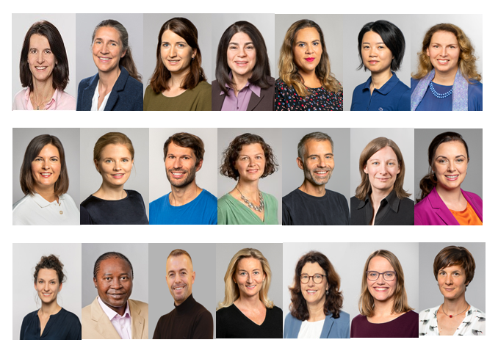
Student Advising and Information Services
See you!

